Slide 1
PYTHON

Slide 2
Python Variables, Constants and Literals
A variable is a named location used to store data in the memory.
Example: 1 :Declaring and assigning value to a variable
website = "apple.com"
print(website)
output: apple.com
Example 2: Changing the value of a variable
website = "apple.com"
print(website)
# assigning a new value to website
website = "programiz.com"
print(website)
Output
apple.com
programiz.com

Slide 3

Multiple Assignment:
Multiple assignment can be done in Python at a time.
Assigning single value to multiple variable
x=y=z=50
print (x)
print (y)
print (z)

Slide 4
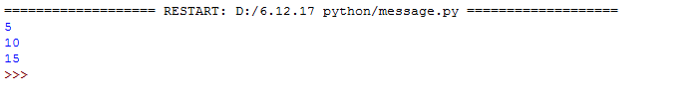
Multiple Assignment:
2.Assigning multiple values to multiple variables:
a,b,c=5,10,15
print (a)
print (b)
print (c)

Slide 5
Assigning multiple values to multiple variables
a, b, c = 5, 3.2, "Hello"
print (a)
print (b)
print (c)
x = y = z = "same"
print (x)
print (y)
print (z)

Slide 6
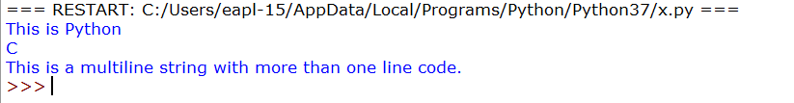
String literals
A string literal is a sequence of characters surrounded by quotes. We can use both single, double, or triple quotes for a string.
Example
x = "This is Python"
y= 'C'
z = """This is a multiline string with more than one line code."""
print(x)
print(y)
print(z)

Slide 7
Python Comments
In Python, we use the hash (#) symbol to start writing a comment.
Single line comment
#This is a comment
#print out
Hello print('Hello’)
Multiline comment
‘’’This is also a perfect example of multi-line comments’’’

Slide 8
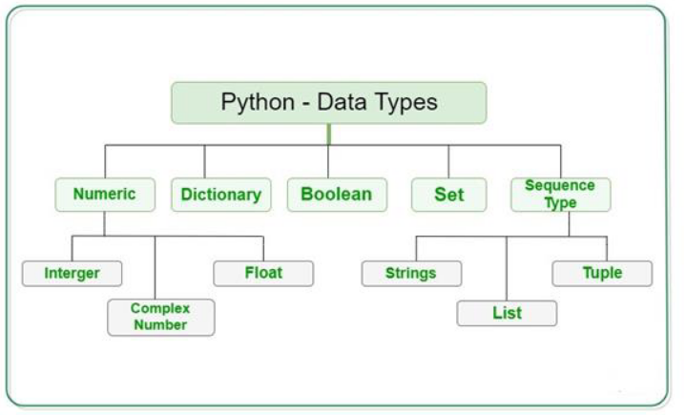
Python Data Type:

Slide 9
Datatypes
Python has five standard data types :-
Numberic ( Integer,Float)
String (strings)
Boolean
List
Tuple
Dictionary

Slide 10
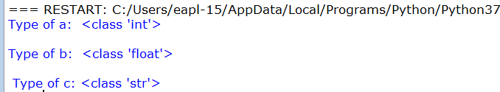
# Python program to
# demonstrate numeric value
a = 5
print("Type of a: ", type(a))
b = 5.0
print("\nType of b: ", type(b))
c=“welcome”
Print(“\n Type of c:”,type(c))

Slide 11
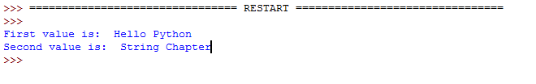
Python Strings
ch = 'Hello Python'
str1 = "String Chapter"
print ("First value is: " , ch)
print ("Second value is: " , str1)

Slide 12
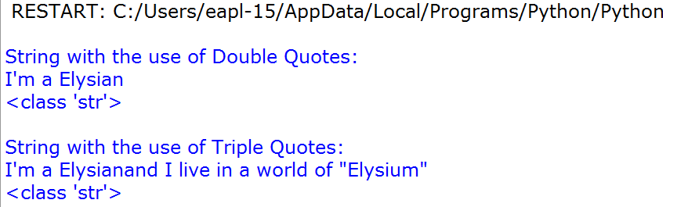
# Creating a String
# with double Quotes
print("\nString with the use of Double Quotes: ")
String1 = "I'm a Elysian"
print(String1)
print(type(String1))
# Creating a String
# with triple Quotes
String1 = '''I'm a Elysianand I live in a world of "Elysium"'''
print("\nString with the use of Triple Quotes: ")
print(String1)
print(type(String1))

Slide 13

Python Strings Using Slice
ch = "Hello Python"
str1 = "String Chapter"
print ("First single sub-string is: " , ch[0])
print ("Set of sub-string is: " , str1[2:6])

Slide 14
Python Strings using Slice
str = 'Hello World!'
print (str ) # Prints complete string
print (str[0]) # Prints first character of the string
print (str[2:5]) # Prints characters starting from 3rd to 5th
print (str[2:]) # Prints string starting from 3rd character
print (str * 2) # Prints string two times
print (str + "TEST") # Prints concatenated string

Slide 15
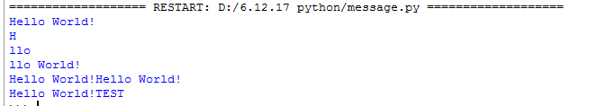
Python Strings

Slide 16
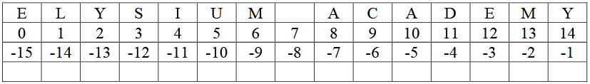
Accessing elements of String Python, individual characters of a String can be accessed by using the method of Indexing.
Indexing allows negative address references to access characters from the back of the String, e.g. -1 refers to the last character, -2 refers to the second last character and so o

Slide 17
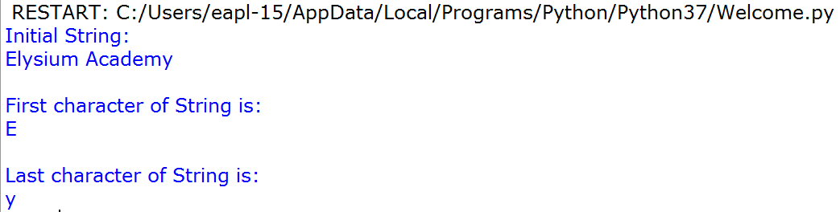
# Python Program to Access
# characters of String
String1 = "Elysium Academy"
print("Initial String: ")
print(String1)
# Printing First character
print("\nFirst character of String is: ")
print(String1[0])
# Printing Last character
print("\nLast character of String is: ")
print(String1[-1])

Slide 19


Python input():
The input() method reads a line from input, converts into a string and returns it.
Syntax:
input([prompt])
Example 1 : How input() works in Python?
# get input from user
data = input(‘Enter a String)
print('The inputted string is:’, data)
Example :2
print("Enter your name:")
x = input()
print("Hello, " + x)

Slide 20
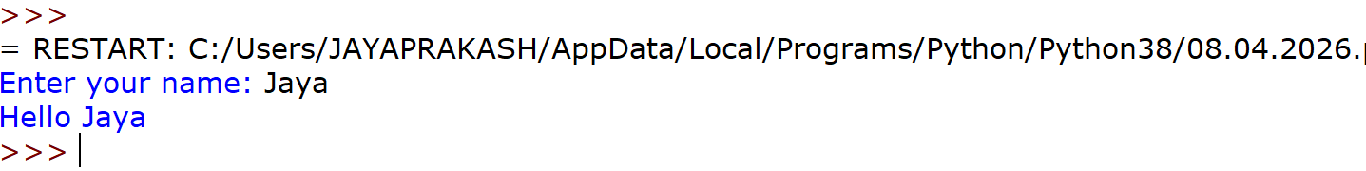
Single Input Program
Problem: Get user name and print it
Sample Input
Enter your name: Jaya
Sample Output
Hello Jaya
name = input("Enter your name: ")
print("Hello", name)

Slide 21
String + Integer Input
Problem: Student details
Sample Input
Enter name: Arun
Enter age: 21
Sample Output
Name: Arun
Age: 21
name = input("Enter name: ")
age = int(input("Enter age: "))
print("Name:", name)
print("Age:", age)

Slide 22
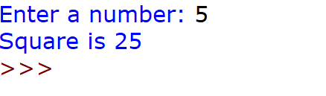
Integer Input Program
Problem Statement : Find square of a number
Sample Input
Enter a number: 5
Sample Output
Square is 25
num = int(input("Enter a number: "))
square = num * num
print("Square is", square)

Slide 23
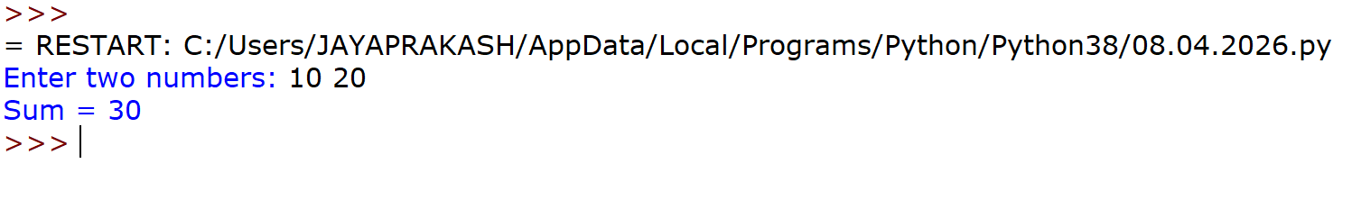
Multiple Inputs (Same Line)
Sample Input
Enter two numbers: 10 20
Sample Output
Sum = 30
a, b = map(int, input("Enter two numbers: ").split())
print("Sum =", a + b)

Slide 24
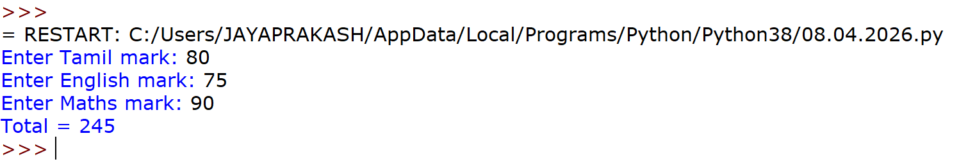
Multiple Inputs (Different Lines)
Problem: Total marks
Sample Input
Enter Tamil mark: 80
Enter English mark: 75
Enter Maths mark: 90
Sample Output
Total = 245
tamil = int(input("Enter Tamil mark: "))
english = int(input("Enter English mark: "))
maths = int(input("Enter Maths mark: "))
total = tamil + english + maths
print("Total =", total)

Slide 25
Real-Time Example (Payment)
Problem statement #1 : Payment details
Sample Input
Enter CreditCard Payment Amount: 1000
Enter UPI Payment Amount: 500
Sample Output
Paid 1000 using Credit Card
Paid 500 using UPI
credit = int(input("Enter CreditCard Payment Amount: "))
upi = int(input("Enter UPI Payment Amount: "))
print("Paid", credit, "using Credit Card")
print("Paid", upi, "using UPI")

Slide 26
Data Types
Problem Statement #2
Write a Python program to take different types of input (integer, float, string) and display their data types.
Sample Input
Enter integer: 5
Enter float: 3.5
Enter name: John
Sample Output
Integer type: <class 'int'>
Float type: <class 'float'>
String type: <class 'str'>

Slide 27
Program
# Data Type Example
num = int(input("Enter integer: "))
decimal = float(input("Enter float: "))
name = input("Enter name: ")
print("Integer type:", type(num))
print("Float type:", type(decimal))
print("String type:", type(name))

Slide 28
Program to enter details of an Student Marks and average and print them. ’
rollno=int(input("Enter your Roll no\t"))
name=input("Enter your name\t")
math=float(input("Enter your marks in Math\t"))
physics=float(input("Enter your marks in Physics\t"))
chemistry=float(input("Enter your marks in Chemistry\t"))
print("Welcome\t ",name)
print("Your Roll no is\t ",rollno)
print("Marks in Maths is\t ",math)
print("Marks in Physics is\t ",physics)
print("Marks in Chemistry is\t ",chemistry)
print("Average marks is \t",(math+physics+chemistry)/3)

Slide 29
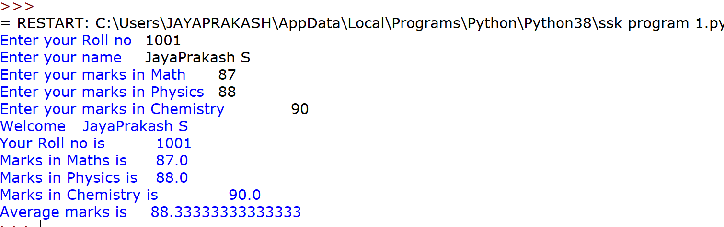

Slide 30
Python Operator
Python divides the operators in the following groups:
Arithmetic operators
Assignment operators
Comparison operators
Logical operators
Identity operators
Membership operators

Slide 31
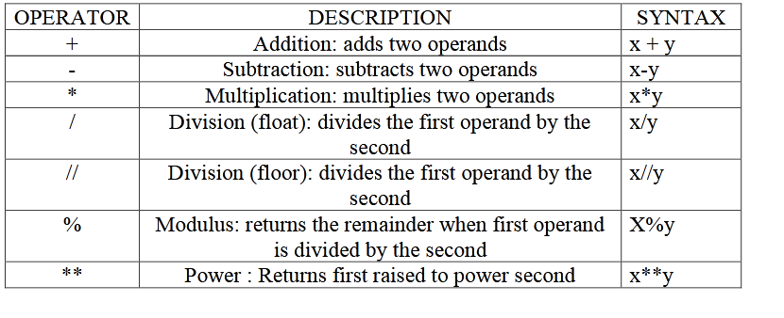
Arithmetic operators
Arithmetic operators:Arithmetic operators are used to perform mathematical operations like addition, subtraction, multiplication and division.

Slide 32
Program
x = 5
y = 3
# Addition of numbers
print(x + y)
# Subtraction of numbers
print(x - y)
# Multiplication of number
print(x * y)
x = 12
y = 3
# Divisionof number
print(x / y)

Slide 33
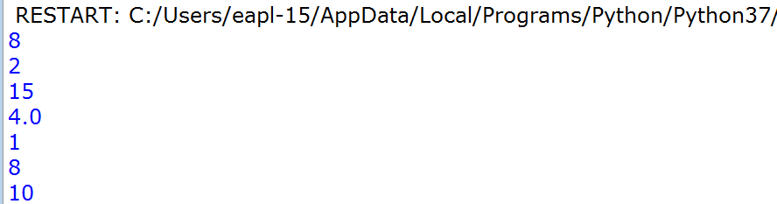
X=5
Y=2
print(x % y)
x = 2
y = 3
print(x ** y) #same as 2*2*2
x = 21
y = 2
print(x // y)
#the floor division // rounds the result down to the nearest whole number

Slide 34
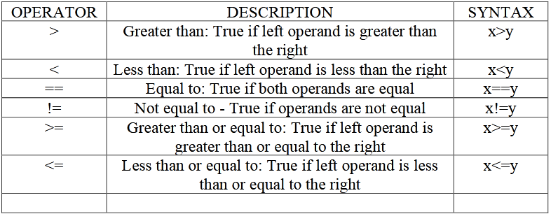
Relational Operators:
Relational operators compares the values. It either returns True or False according to the condition

Slide 35
a = 13
b = 33
# a > b is False
print(a > b)
# a < b is True
print(a < b)
# a == b is False
print(a == b)
# a != b is True
print(a != b)
# a >= b is False
print(a >= b)
# a <= b is True
print(a <= b)
OutPut:
False
True
False
True
False
True

Slide 36
x = 5
y = 3
print(x == y)
# returns False because 5 is not equal to 3
x = 5
y = 3
print(x != y)
# returns True because 5 is not equal to 3
x = 2
y = 3
print(x > y)

Slide 37
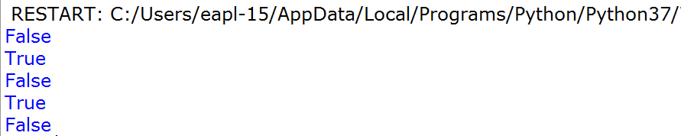
x = 3
y = 3
print(x >= y)
x = 5
y = 3
print(x <= y)
# returns False because 5 is neither less than or equal to 3

Slide 38
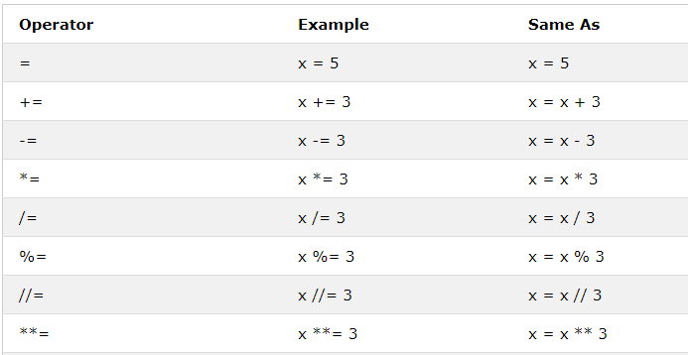
Python Assignment Operators

Slide 39
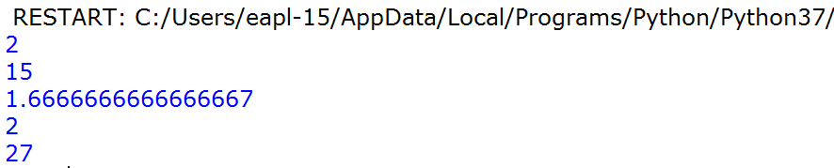
x = 5
x -= 3
print(x)
x = 5
x *= 3
print(x)
x = 5
x /= 3
print(x)
x = 5
x%=3
print(x)
x = 3
x **= 3
print(x)

Slide 40
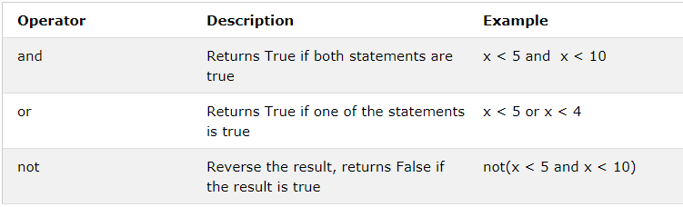
Python Logical Operators
Logical operators perform Logical AND, Logical OR and Logical NOT operations.

Slide 41
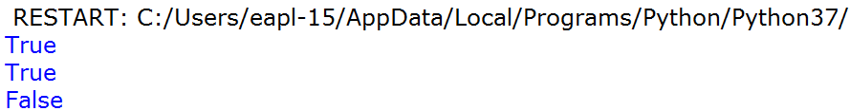
x = 5
print(x > 3 and x < 10)
# returns True because 5 is greater than 3 AND 5 is less than 10
x = 5
print(x > 3 or x < 4)
# returns True because one of the conditions are true (5 is greater than 3, but 5 is not less than 4)
x = 5
print(not(x > 3 and x < 10))
# returns False because not is used to reverse the result

Slide 42
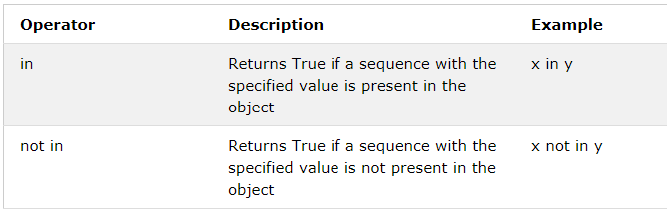
Membership operators
in and not in are the membership operators; used to test whether a value or variable is in a sequence.
in True if value is found in the sequence
not in True if value is not found in the sequence

Slide 43
x = ["apple", "banana"]
print("banana" in x)
# returns True because a sequence with the value "banana" is in the list
x = ["apple", "banana"]
print("pineapple" not in x)
# returns True because a sequence with the value "pineapple" is not in the list
True
True

Slide 44

Python Identity Operators
x = ["apple", "banana"]
y = ["apple", "banana"]
z = x
print(x is z)
# returns True because z is the same object as x
print(x is y)
# returns False because x is not the same object as y, even if they have the same content

Slide 45
x = ["apple", "banana"]
z = x
print(x is not z)
# returns False because z is the same object as x
Output:
False

Slide 47
Conditional Statements
Python supports the usual logical conditions from mathematics:
Equals: a == b
Not Equals: a != b
Less than: a < b
Less than or equal to: a <= b
Greater than: a > b
Greater than or equal to: a >= b

Slide 48
If statement:
a = 33
b = 200
if b > a:
print("b is greater than a")
b is greater than a

Slide 49
elif elif statement allows you to check multiple expressions for TRUE and execute a block of code as soon as one of the conditions evaluates to TRUE.
Syntax
if expression1:
statement(s)
elif expression2:
statement(s)
elif expression3:
statement(s)
else:
statement(s)

Slide 50
else
a = 200
b = 33
if b > a:
print("b is greater than a")
else:
print("b is not greater than a")
Output:
B is not greater than a

Slide 51
else
a = 200
b = 20
if b > a:
print("b is greater than a")
elif a == b:
print("a and b are equal")
else:
print("a is greater than b")
Output:
a is greater than b

Slide 52
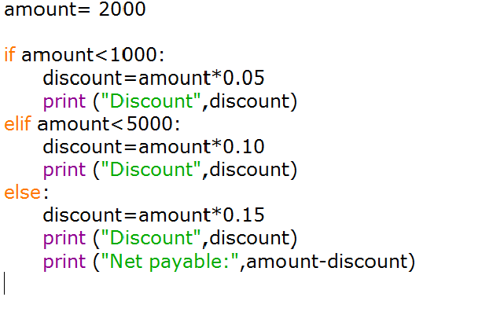

Slide 53
Nested IF Statements
The syntax of the nested if...elif...else construct may be
If expression1:
statement(s)
if expression2:
statement(s)
elif expression3:
statement(s)
else
statement(s)
else:
statement(s)

Slide 54

Python nested IF statements
var = 100
if var < 200:
print ("Expression value is less than 200")
if var == 150:
print ("Which is 150")
elif var == 100:
print ("Which is 100")
elif var == 50:
print ("Which is 50")
elif var < 50:
print ("Expression value is less than 50")
else:
print ("Could not find true expression")
print ("Good bye!")

Slide 55
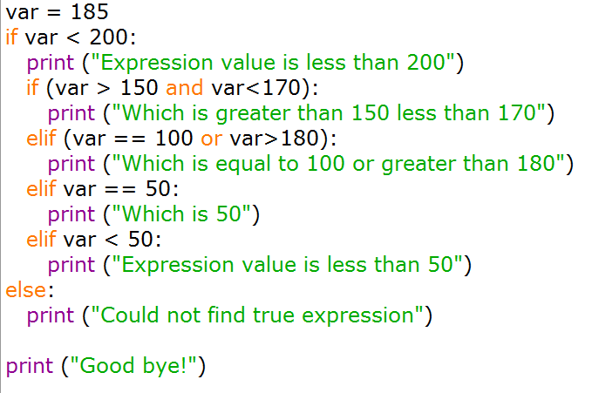
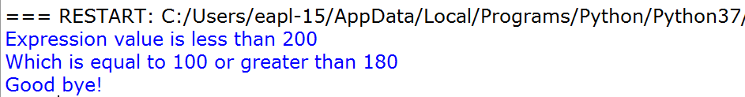

Slide 57
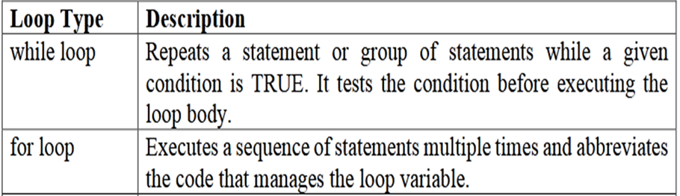
Loops

Slide 58
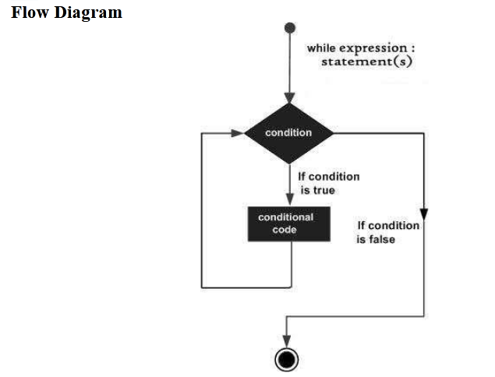
while Loop Statements
Syntax:
while expression:
statement(s)

Slide 59
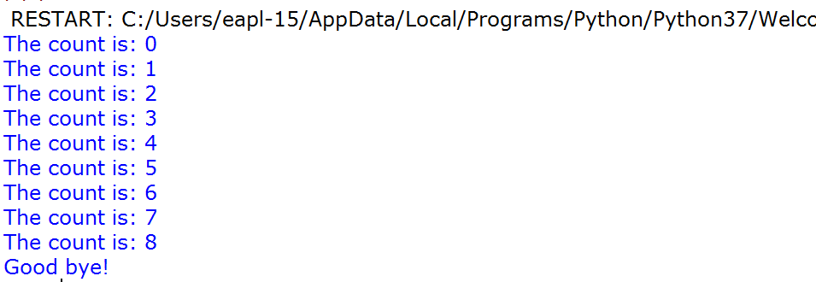
example
count = 0
while (count < 9):
print ('The count is:', count)
count = count + 1
print ("Good bye!")
i = 1
while i < 6:
print(i)
i += 1

Slide 60
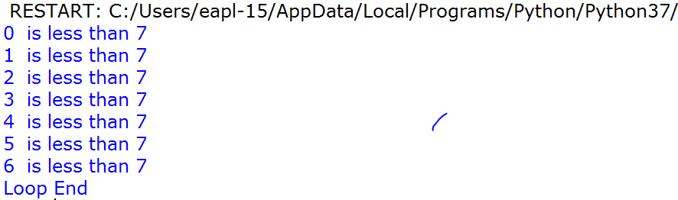
count = 0
while count < 7:
print (count, " is less than 7")
count = count + 1
else:
print (“Loop End")

Slide 61
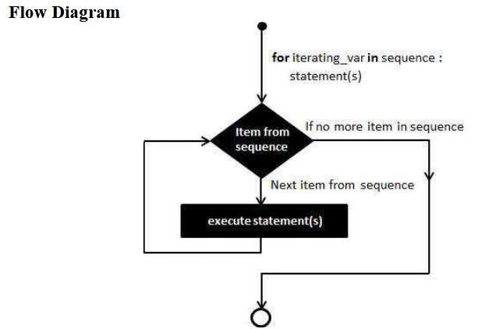
for Loop Statements
The for statement in Python has the ability to iterate over the items of any sequence, suchas a list or a string.
Syntax:
for iterating_var in sequence:
statements(s)

Slide 62
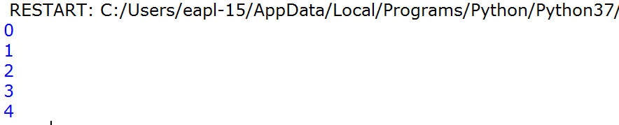
range() function
The built-in function range() is the right function to iterate over a sequence of numbers. It generates an iterator of arithmetic progressions.
>>> range(5)
range(0, 5)
>>> list(range(5))
[0, 1, 2, 3, 4]
range() generates an iterator to progress integers starting with 0 upto n-1
for var in list(range(5)):
print (var)

Slide 63
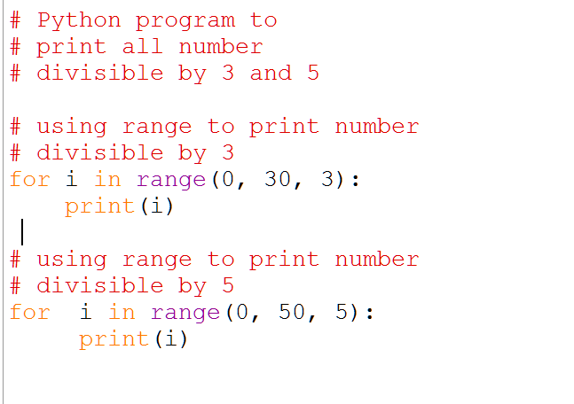
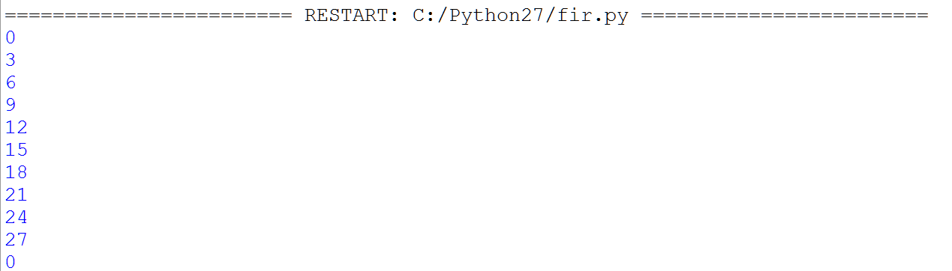
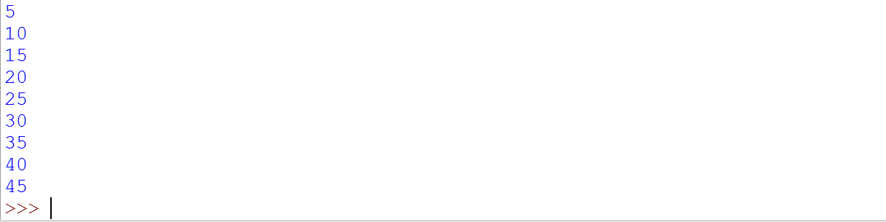


Slide 65
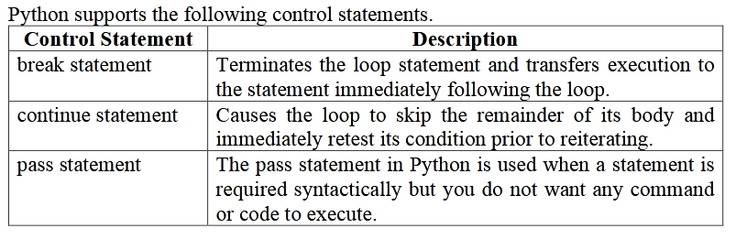
Loop Control Statements

Slide 66
Break / Continue statement
1.The break statement is used for Stops the loop immediately
Syntax:
break
2. continue Statement
Skips current iteration and moves to next
3. pass Statement
a. Does nothing (placeholder)
b. Purpose of pass in Python
pass is a null (empty) statement — it does nothing, but it is used to avoid syntax errors when a statement is required.
placeholder for future code
Used when you plan to write code later

Slide 67
1.break
for i in range(1, 6):
if i == 3:
break
print(i)
Output
1
2
When i = 3, loop stops completely
2. continue Statement
Output
1
2
4
5
When i = 3, it is skipped
for i in range(1, 6):
if i == 3:
continue
print(i)

Slide 68
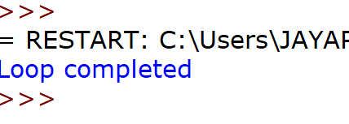
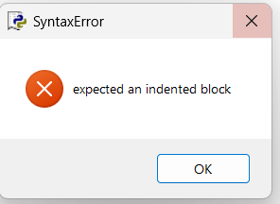
Pass statement
To create an empty block
Python requires at least one statement inside blocks (if, for, function, etc.)
for i in range(1, 4):
pass
print("Loop completed")
Empty Condition Block
for i in range(1, 4):
print("Loop completed")
x = 10
if x > 5:
pass
else:
print("Less than 5")
print("Done")
Output
Done
if block is empty but no error occurs

Slide 69
Python format() Method
The format() method is used to insert values into a string and perform string formatting.
During formatting, we use curly braces {} as placeholders. These braces are replaced by the values provided to the format() method.
Basic Syntax
"string {}".format(value)
Remember:
{} = Placeholder
format() = Supplies the values

Slide 70
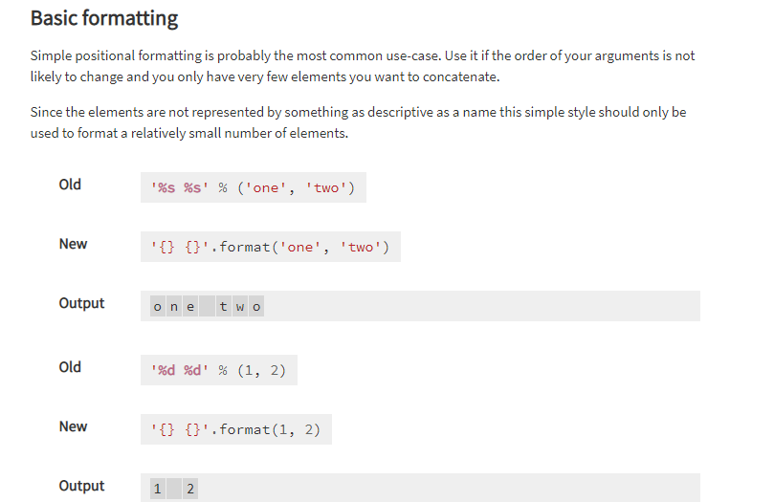
https://pyformat.info/

Slide 71
Old String formate
# This prints out "Hello, John!"
name = "John"
print("Hello, %s!" % name)
# This prints out "John is 23 years old."
name = "John"
age = 23
print("%s is %d years old." % (name, age))

Slide 72
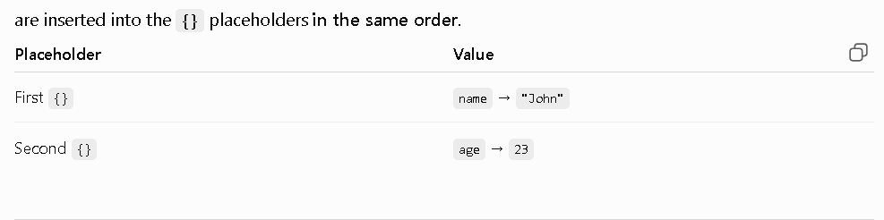
New String Format {} Method
Basic format()
name = "John"
age = 23
print("My name is {} and I am {} years old.".format(name, age))
‘
Output
My name is John and I am 23 years old.
How it works
"My name is {} and I am {} years old."
↑ ↑
Placeholder Placeholder

Slide 73
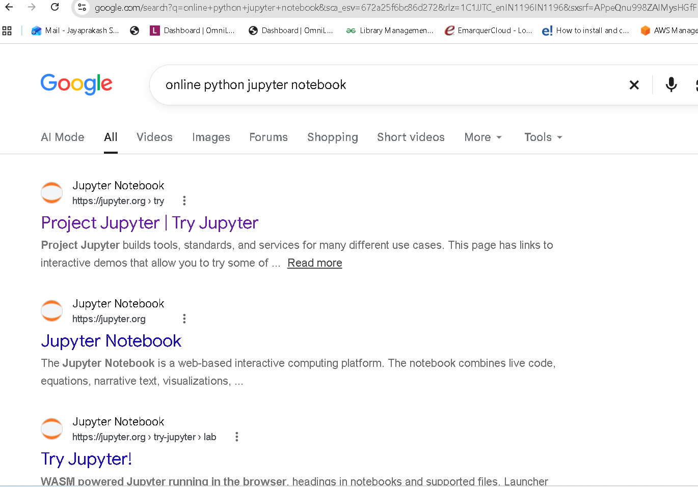

Slide 74
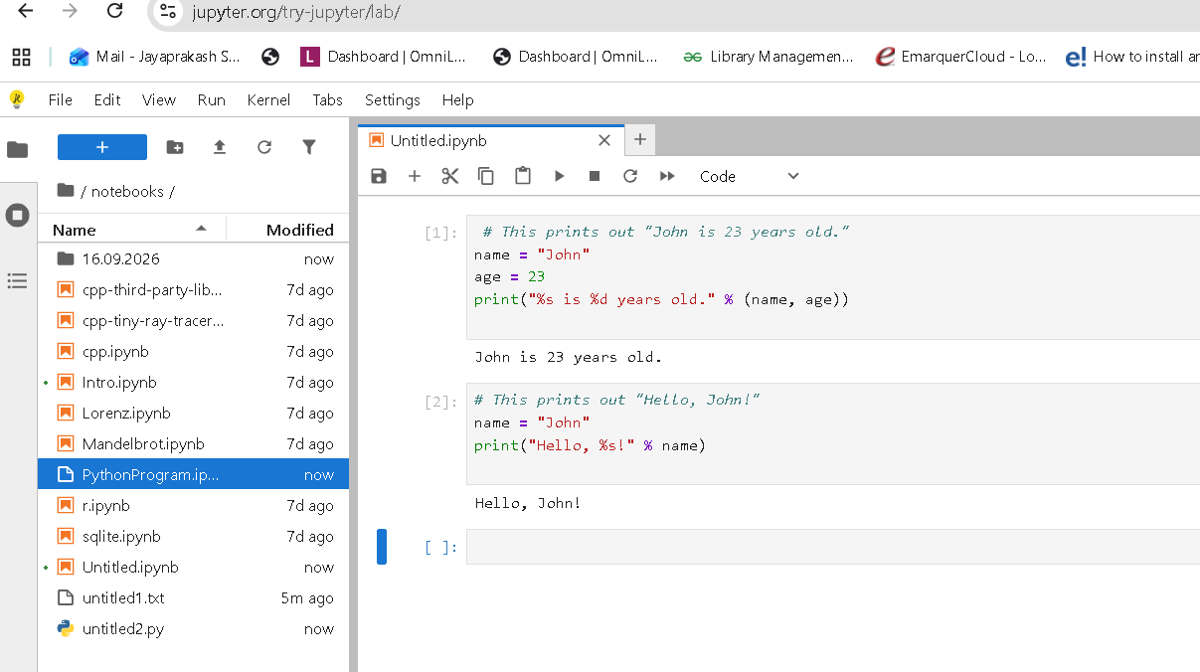

Slide 75
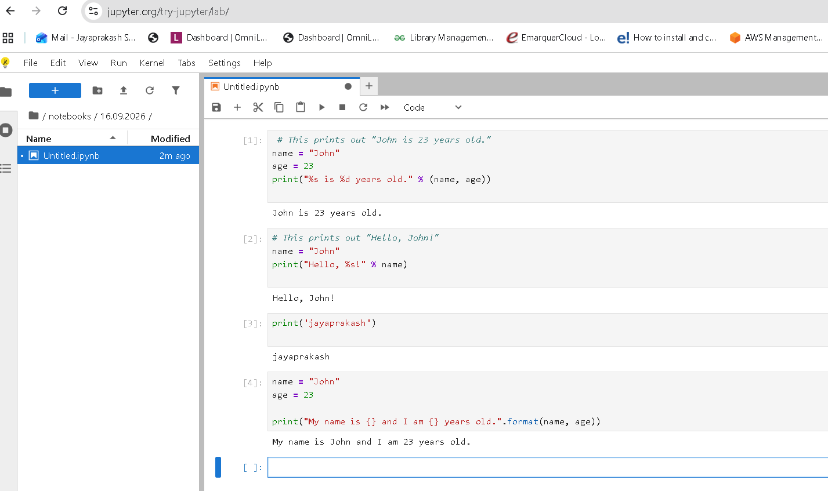

Slide 76

Python String format() Method {} :
Python 3 format() method is used to perform format operations on string. While formatting string a delimiter {} (braces) is used to replace it with the value.
#named indexes:
txt1 = "My name is {fname}, I'm {age}".format(fname = "John", age = 36)
#numbered indexes:
txt2 = "My name is {0}, I'm {1}".format("John",36)
#empty placeholders:
txt3 = "My name is {}, I'm {}".format("John",36)
print(txt1)
print(txt2)
print(txt3)

Slide 77
# Python format() function example
# Variable declaration
str = "Java"
str2 = "C#"
# Calling function
str3 = "{} and {} both are programming languages".format(str,str2)
# Displaying result
print(str3)

Slide 78
Python program to do arithmetical operations
# Store input numbers:
num1 = input('Enter first number: ')
num2 = input('Enter second number: ')
# Add two numbers
sum = float(num1) + float(num2)
# Subtract two numbers
min = float(num1) - float(num2)
# Multiply two numbers
mul = float(num1) * float(num2)
#Divide two numbers
div = float(num1) / float(num2)

Slide 79
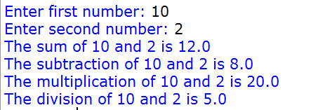
# Display the sum
print('The sum of {0} and {1} is {2}'.format(num1, num2, sum))
# Display the subtraction
print('The subtraction of {0} and {1} is {2}'.format(num1, num2, min))
# Display the multiplication
print('The multiplication of {0} and {1} is {2}'.format(num1, num2, mul))
# Display the division
print('The division of {0} and {1} is {2}'.format(num1, num2, div))

Slide 80

Python program to swap two variables
# Python swap program
x = input('Enter value of x: ')
y = input('Enter value of y: ')
# create a temporary variable and swap the values
temp = x
x = y
y = temp
print('The value of x after swapping: {}'.format(x))
print('The value of y after swapping: {}'.format(y))

Slide 81
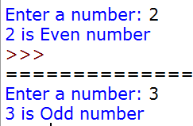
Python Program to Check if a Number is Odd or Even
num = int(input("Enter a number: "))
if (num % 2) == 0:
print("{0} is Even number".format(num))
else:
print("{0} is Odd number".format(num))

Slide 82
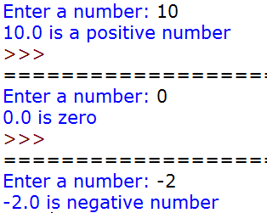
Python Program to check if a Number is Positive, Negative or Zero
num = float(input("Enter a number: "))
if num > 0:
print("{0} is a positive number".format(num))
elif num == 0:
print("{0} is zero".format(num))
else:
print("{0} is negative number".format(num))

